Slide 1

Code Innovation Series - Maharaja Agrasen Institute Of Technology
Hackers
Team Name:
problem statement:
Health-Tech

Slide 2

Problems people are currently facing
Patient centred Information exchange system:
Currently, there are multiple barriers to patient-centric IE in the current system, such as security and privacy concerns, data inconsistency, timely access to the right records across multiple healthcare facilities, etc.
Holistic Individual Health:
Identifying, addressing, and improving the member/patient’s overall medical is still lacking.
Consumer experience:
Understanding, addressing, and assuring that all consumer interactions and outcomes are easy, convenient, timely to ensure satisfaction.

Slide 3
Solutions on which we are working on
Patient’s data is 100% safe and private, access of which is only to us and the patient. Doctors will get that data when requested.
Individually personalized reports will be stored in our database which will help us, as well as patient, in monitoring their condition.
Getting reviews by each user according to their experience will definitely improve the consumer experience for others.

Slide 4
Our Solutions
Making healthcare facilities easily accessible.
Integrated platform providing appointment, delivering medicines, and tests.
Convenient to manage details.
24 X 7 availability of doctors.
Individually personalized report stored in our database for future reference.
Collaboration with multiple hospitals for emergency ,surgery etc .
Availability of vaccine related information will be mailed to the user.

Slide 5


DOOGLE HEALTH CARE
We give the world’s best service!

Slide 6

Description
We are preparing a website to help people suffering due to lack of resources.
We are designing our website with the help of HTML, CSS & BOOTSTRAP.
For back-end, we are using JAVASCRIPT.
In the back-end, we also have a database to store personal details of our patients and about the availability of resources.
Our website is unique as it is simple and easy to operate, with multiple functional design.
It is secure and accurate, with full database integrity.

Slide 7
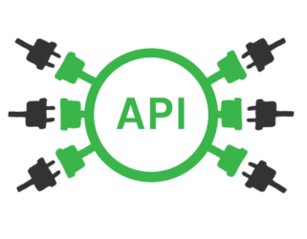
APIs Used
In this website, we embedded two APIs which will help user in easy access of various data at a particular moment.
Places API: This API of Google Maps will help users in locating hospitals near them.
Co-WIN Public API: This API will give information regarding availability of vaccine slots and appointments for a particular Pin Code or district.

Slide 8
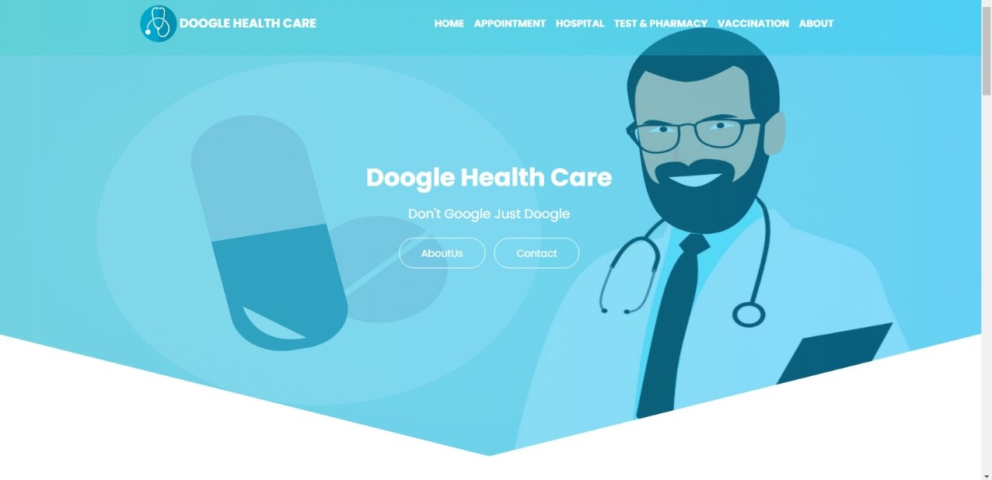
Layout of our designed website:

Slide 9
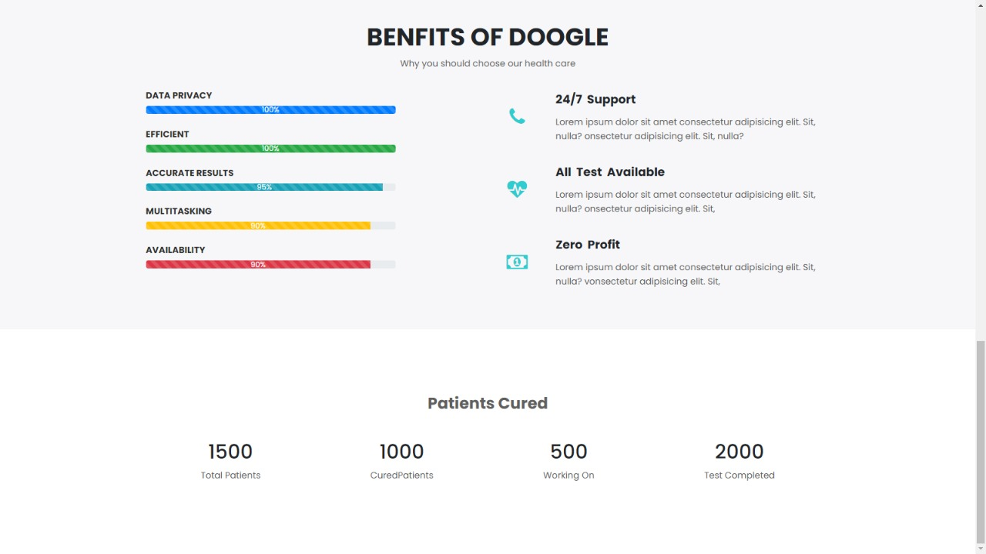

Slide 10
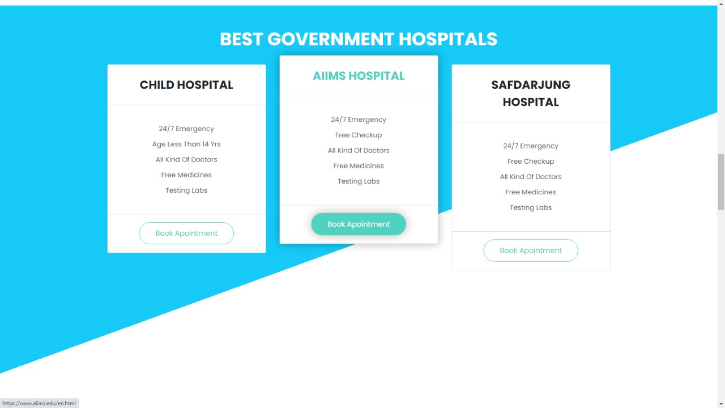

Slide 11
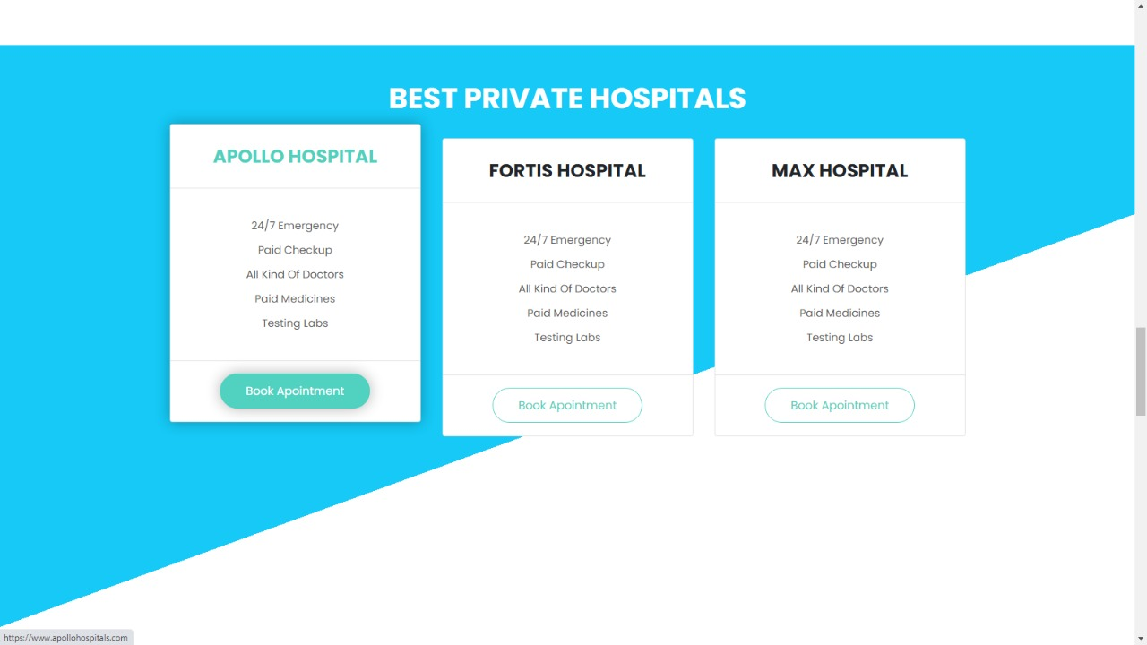

Slide 12
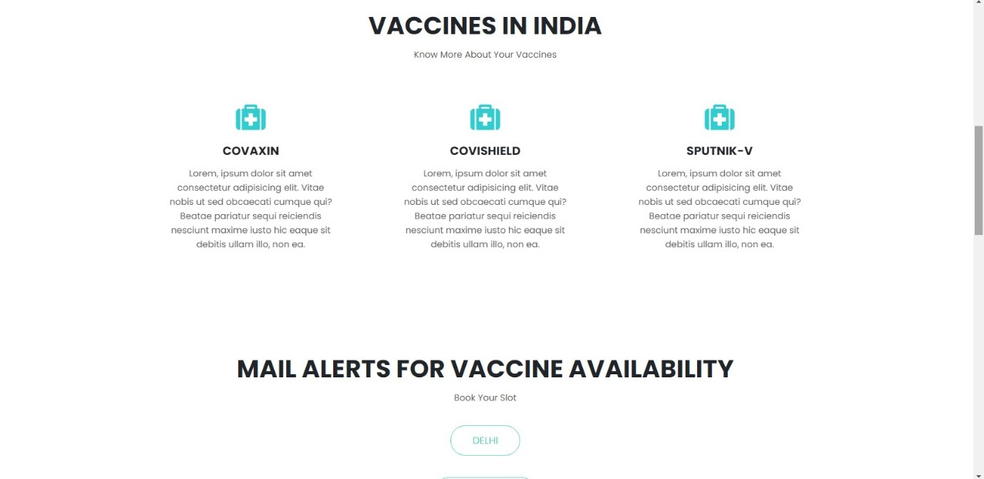

Slide 13
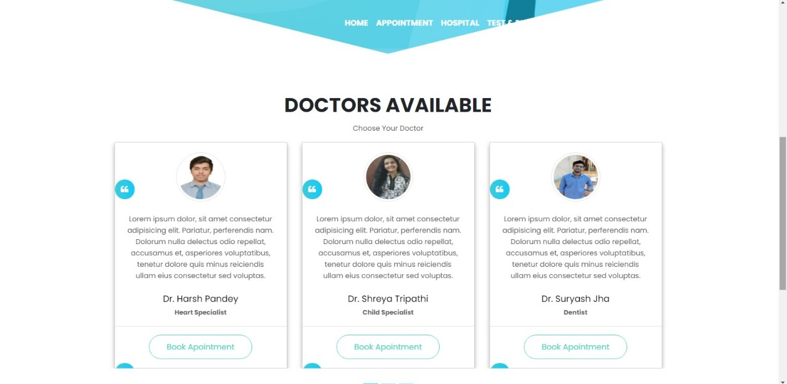

Slide 14
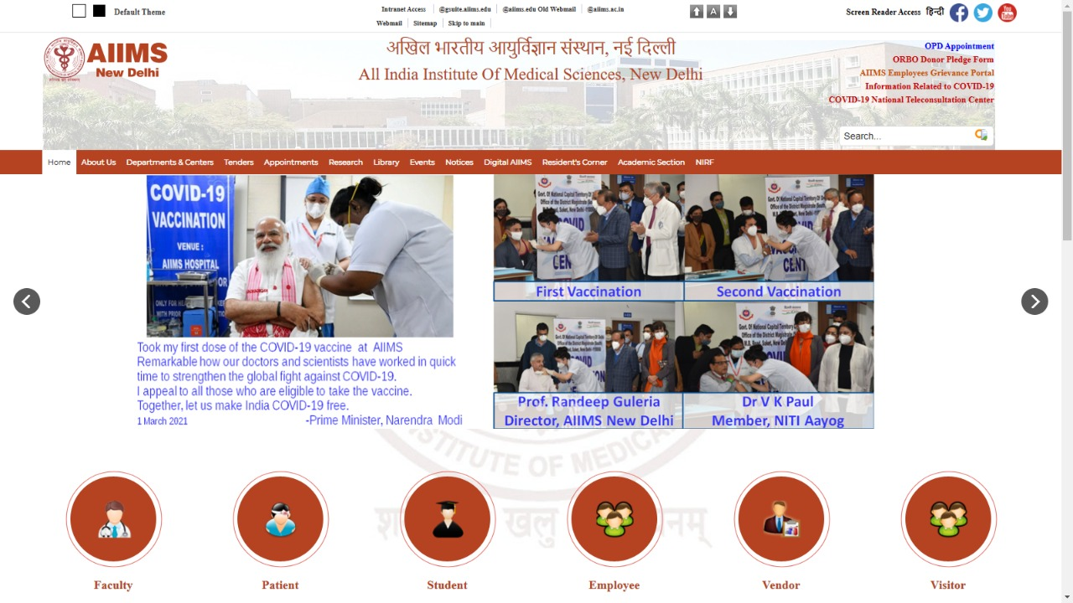

Slide 15
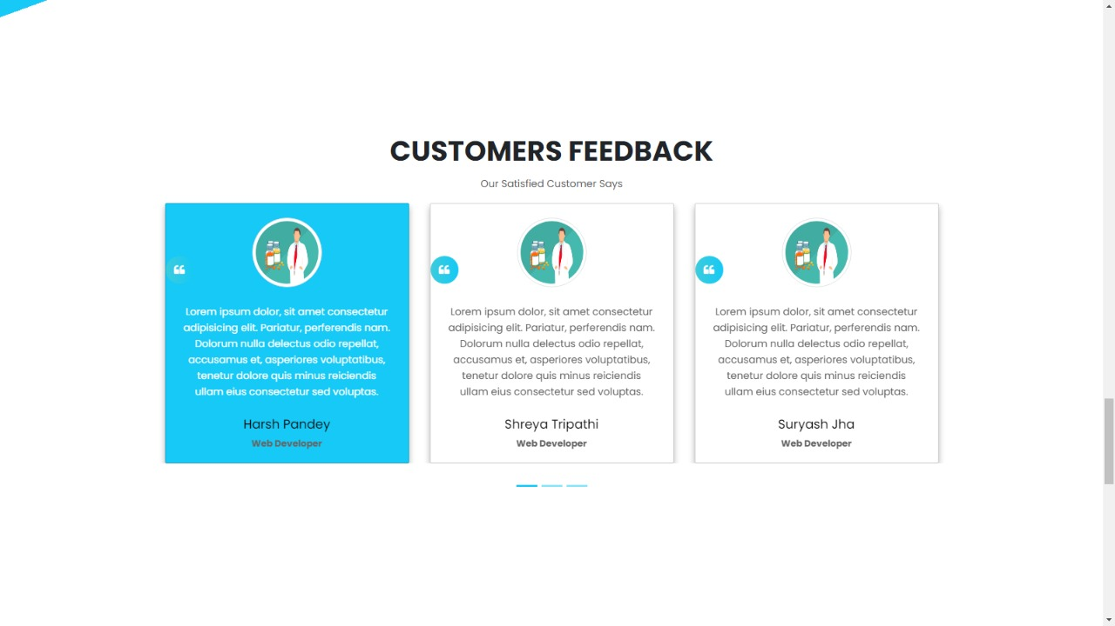

Slide 16
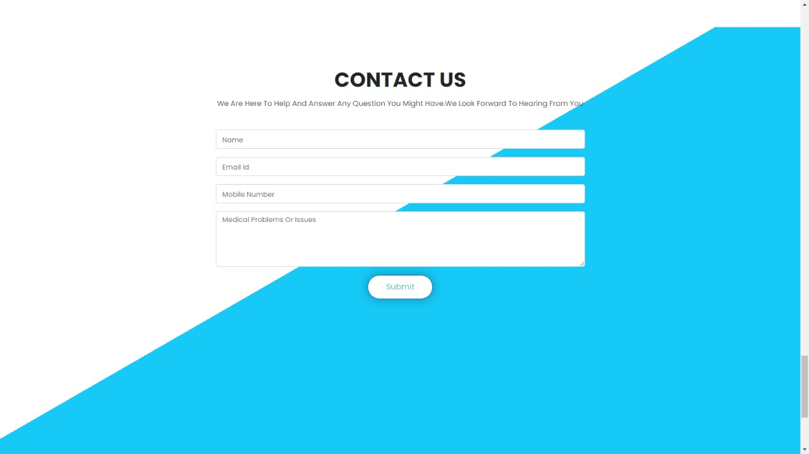

Slide 17
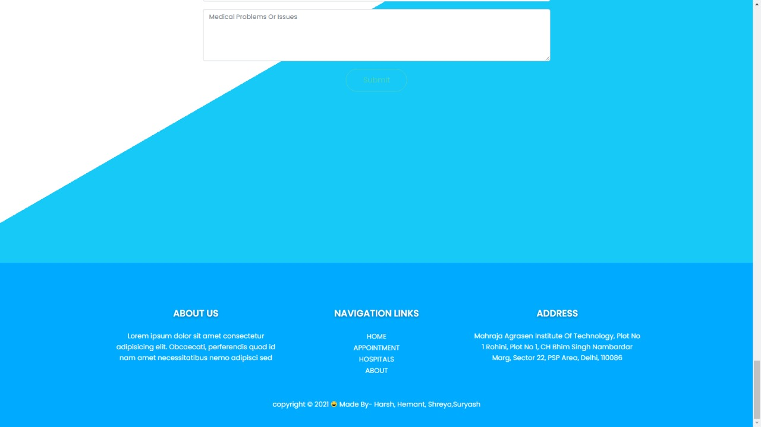

Slide 18
INDEX
Working and Application
Appointments
Nearby Hospitals
Testing Labs
Contact Us
1
2
3
4
5

Slide 19
Working and Application
During this pandemic situation, to help people we are preparing an easy website.
Basically, it has 3 main features: Appointments
Hospitals nearby
Pharmacy and Tests
Our site is synced with the database, thus gets automatically
refreshed in 30 mins, which increases the accuracy of the program.
We also have a feature to track user’s device and even ask the user to
enter it’s location, so that it can filter the results for ease.
We also have included a feature that enables us to keep
an eye on our website visitors.
Our database is fully secured and 100% privacy is maintain regarding
the personal info of our patients.
Unique patient id’s are also provided to every user to record data
easily and to maintain data integrity.

Slide 20

Appointments
In this section, we allow people to book their appointments with our doctors, online.
When a patient wants to book an appointment, we provide them a brief description about the doctors in our database and allow them to choose a suitable slot.
Then, we collect some of their personal details which gets stored in our back end.
Finally, we give them a confirmation call and book the appointment.

Slide 21

Special Features
Doctors can volunteer for noble cause.
Continuous updating of resources.
24 x 7 Availability of services.
Telegram links for State-wise mail alert regarding vaccination is also provided.
*Appointments can be held online via Zoom meetings or other online conference platforms.
* After registering over the website, a mail will be sent to the user which will have Zoom meeting ID and its password.

Slide 22

Nearby Hospitals
In this section, we first ask the user to enter their location.
Then, we sought our database according to the location given and show all the nearby hospitals in the radius of 20 km from the location provided.
We also keep our database updated about the availability of beds in the hospitals, so that people get the beds easily.
Here, we also provide ratings about the hospital selected, for convenience.

Slide 23
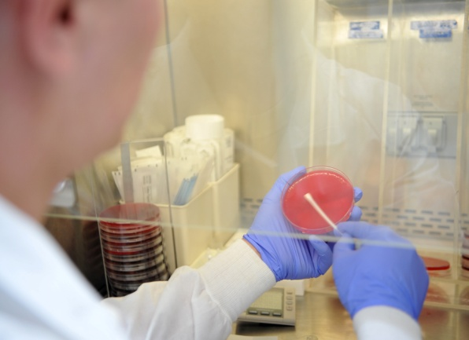
Testing Labs
In this pandemic situation, government is constantly emphasising on more testing.
Here on our website, we provide you with a list of path labs where you can get your COVID-19 test done.
We also have separate options for routine test labs and other scans.
Here, we also allow the user to search the test centres by their location.

Slide 24

Awareness regarding vaccines
Nowadays, via different social media platforms, many myths have been floating around regarding different vaccines and their side effects which are creating unnecessary negative impression among people. So to cripple this, we are trying to create awareness among people by adding a dedicated page for vaccine related information and myth-busters.
On that page, we also added a telegram group link, under which many volunteers are generating and verifying leads regarding bed, oxygen etc. So, it might be helpful for someone in urgent need of these and it will be accessible to all, free of cost.

Slide 25

Contact Us Facility
Generally, we have noticed that the numbers usually given on the websites are either wrong or always busy.
Keeping this in mind, we have a contact us facility where user can provide us their contact details and write a brief about their issue or problem.
This gets stored at our back-end. There we will sort them in categories like emergency and normal and then, will connect back to them within 2-3 hours .

Slide 26
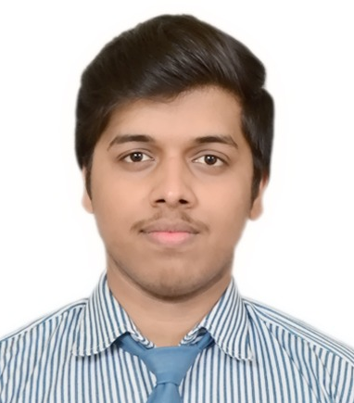
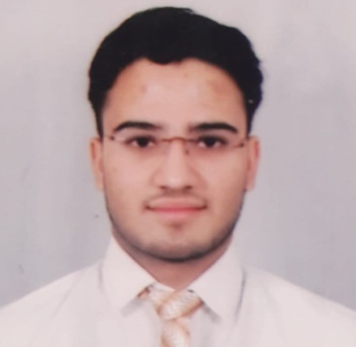
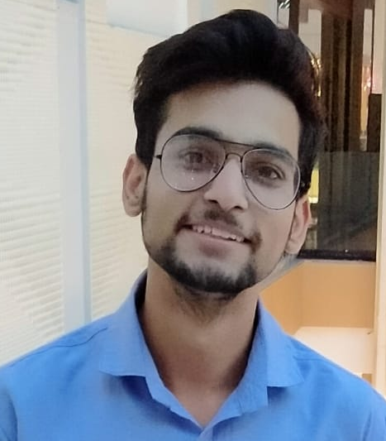
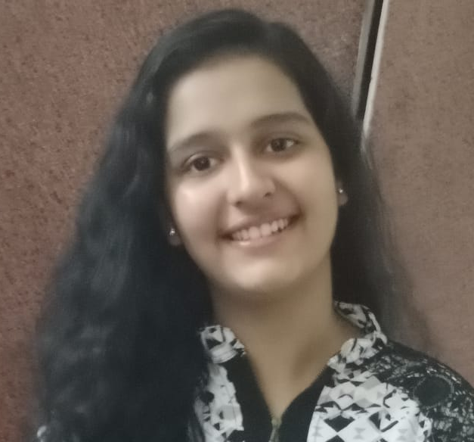
THANK YOU
Harsh Pandey IT- 1st Year Front-End Developer | Hemant Suteri IT- 1st Year Python Programmer
Shreya Tripathi IT- 1st Year Java Programmer | Suryash Kumar Jha IT- 1st Year C++ Programmer

Slide 27
Our Website Drive link
https://drive.google.com/drive/folders/1gVtocSKBRkYbkCkNZZeKmwqkBz0Qvw-V?usp=sharing

